Slide 1
A differential privacy workflow for inference of parameters in the Rasch model
Teresa Anna Steiner, David Enslev Nyrnberg, and Lars Kai Hansen
Notes:
How to do introduction? Introduce ourselves, our positions, etc?
...which means we show how to analyze educational data while satisfying certain privacy guarantees

Slide 2


Overview
Motivation
Differential Privacy
Rasch Model
Our Contribution: Private Workflow
Two Differentially Private Methods
Experimental Results
Conclusion
?
Notes:
Picture! Motivation in the context of educational technology
Short introduction and definition of differential privacy and Rasch model
Describe our workflow of maintaining individual privacy in the Rasch model describe the two differential private methods we used (more “our contribution” here?)
And show our experimental results and discuss our findings.

Slide 3
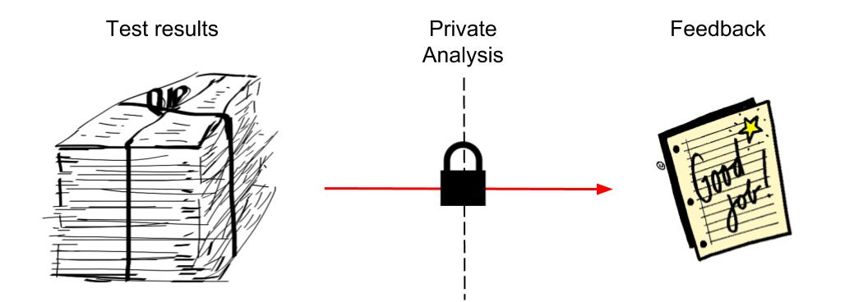
Motivation
Benefits from analyzing educational data
Test results, etc, highly personal
Our Solution: Combining differential privacy and item response theory to provide detailed feedback while preserving privacy
Notes:
Benefits from analyzing educational data: for example in the context of online education - trying to be as effective and efficient as possible
Detailed feedback enhances the learning process
The data can be highly personal and sensitive
Other Rasch Model applications: edutech (originally), medicinal / psychological purposes (rehabilitation, quality of life measures, personality questionnaires), marketing research; we focus on educational technology Pictures: for application

Slide 4
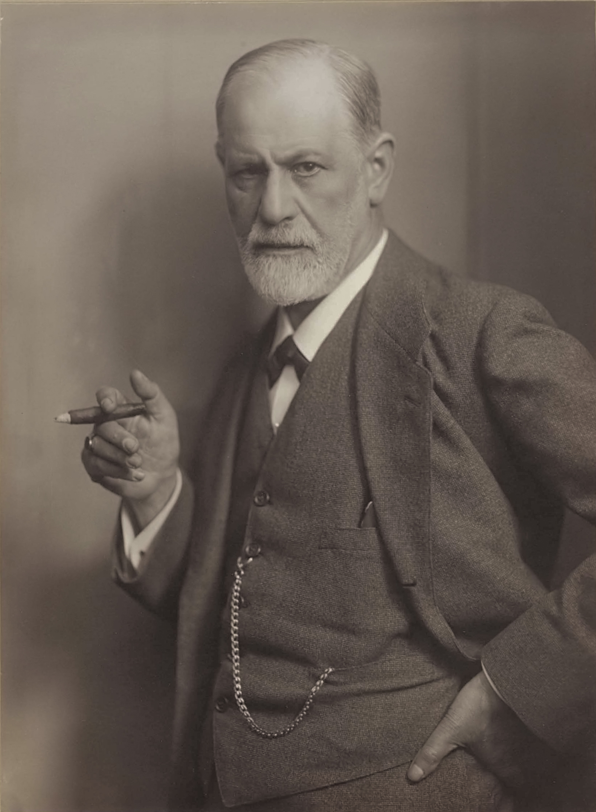


Motivation
Notes:
Something for psychology and marketing research? Don't forget attribution (maybe have extra slide)

Slide 5
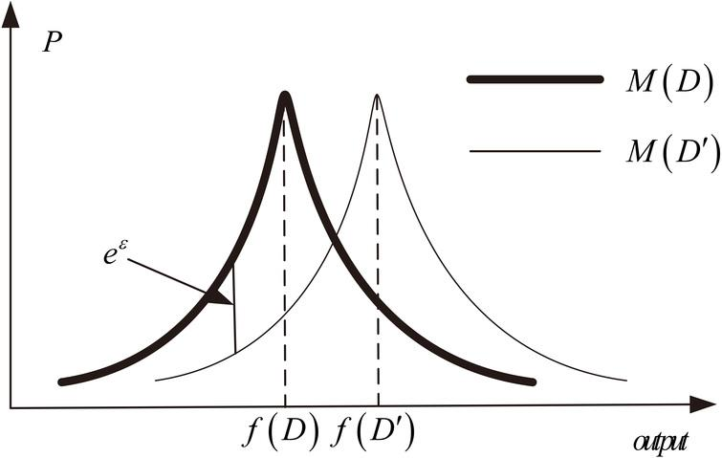
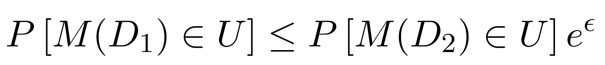
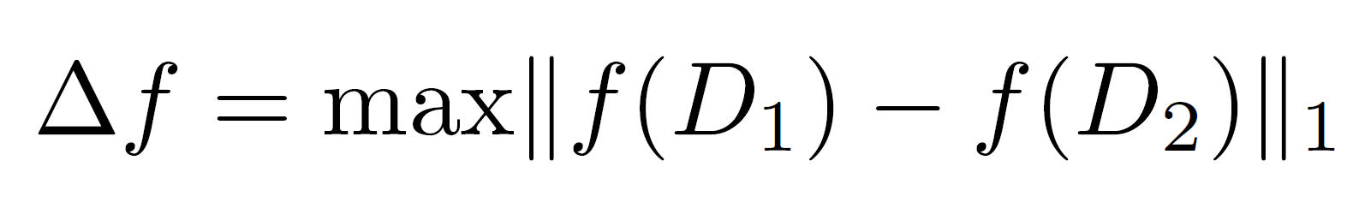
Differential Privacy [Dwork 2006]
Randomized algorithm M
Output distributions similar if data sets differ in one entry:
Add noise to the output scaled with the global sensitivity of a query f:
Laplace-mechanism: release f + Lap(Δf / ε)
Notes:
Intuition for differential privacy: answer some query / do some data analysis, publish results, adversary should with high probability not be able to figure out if an individual was in the set or not; assume complete information; impact performance; tradeoff!
More formally, we want the output distributions to be similar for two data sets D1 D2 that differ in a single entry: describe equation. One way to achieve that is to add noise, either to the output, or at a point wihtin the algorithm, and often the scaling of the noise depends on the global sensitivity, which is a measurement about how much the output of a query can change, if one point in the data set changes. illustration of close probability distributions For example, Dwork at al. Showed that the Laplace Mechanism, which adds Laplace noise scaled with sensitivity / epsilon, is differentially private. This approach is useful in many cases, but for some, either global sensitivity is too high, or difficult to determine, so you have to get more creative. I'll talk more about this later

Slide 6
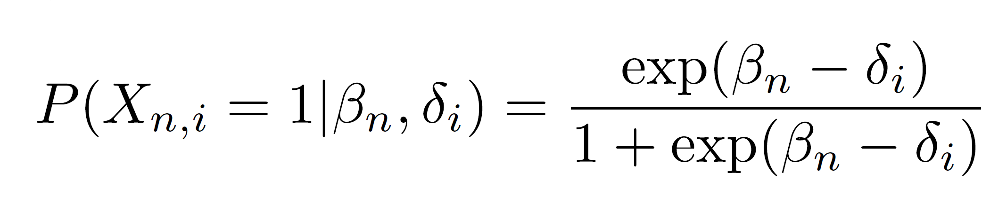
Rasch Model [Rasch1960]
Input Data: Results of a multiple-choice test of I items and N students
Represented by a matrix: X(n,i) = 1 iff student n answered item i correctly
Estimates parameters for item difficulty (δ) and student ability (β)
Defines probability for student n passing test i by
Notes:
Talk a bit about intuition – read up – some picture?? Use data to estimate difficulty of tests depending on how students scored; estimate student abilities by comparing them to other student's performances – relative measurement! ML version of grading
The input data are the results a multiple choice test of I items and N students, which we get as an (N x I) matrix, where an element is 1 if the student answered the item correctly, and 0 otherwise.
Then the Rasch Model estimates parameters for the item difficulty and the student ability,
By defining the probability of a student n passing test I by this logistic function.

Slide 7
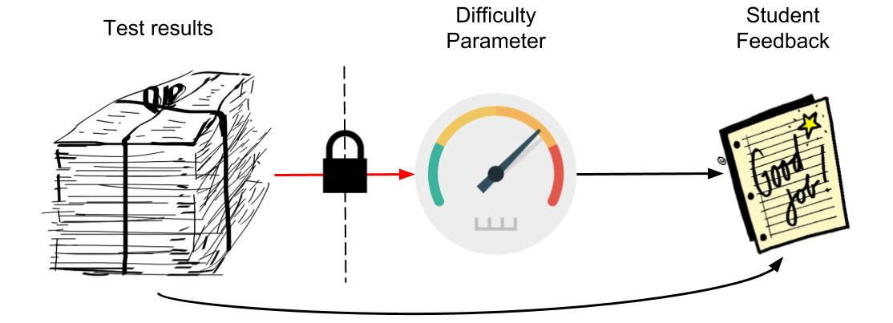
Our Contribution: Private Workflow
Differential Privacy aims at hiding an individual’s data
Yet, we want to provide individual feedback, while keeping everyone else’s data hidden
Solution: estimating difficulty parameters privately; then re-estimating ability parameters [Choppin1983]
Notes:
OK so now that we defined differential privacy and the Rasch model you might have noiticed that there seems to be a contradiction here: Differential Privacy aims at hiding an individual’s data. Yet, we want to provide individual feedback, while keeping everyone else’s data hidden.
Intuitively, changing one student’s data should not influence the test difficulty parameters too much; yet, their own ability measure a lot; and our solution to this is to estimate the difficulty parameters privately; then use those, together with an individuals student data, to estimate their ability. Actually, we first estimate both parameters with a differentially privatized version of the Log-Likelihood estimation, then throw out the private betas (because they are very noisy) and re-estimate them directly with the student's data

Slide 8
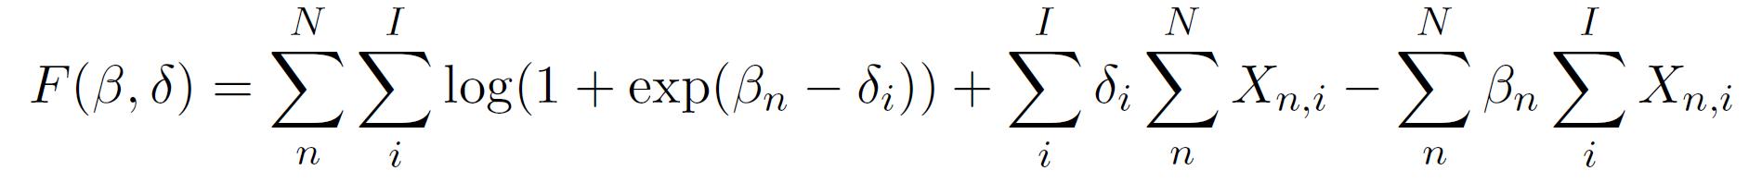
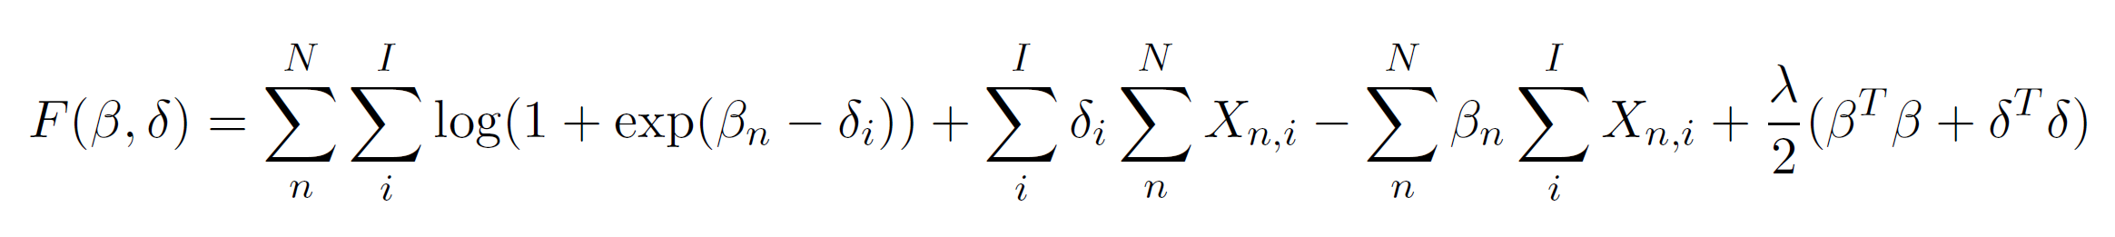
Two Differentially Private Methods
The parameters for the Rasch model are estimated by minimizing the (regularized) negative log-likelihood:
Sufficient statistic approach: noise scaled with (I / ε)
Objective perturbation: noise scaled with (√I / ε)
Notes:
+ traditional (log-) likelihood; explain lambda term – prior information on distribution of beta and delta (Bayes); lambda can be fit on "old data"

Slide 9
Two Differentially Private Methods
The parameters for the Rasch model are estimated by minimizing the (regularized) negative log-likelihood:
Sufficient statistic approach [Foulds2016]: noise scaled with (I / ε)
Objective perturbation: noise scaled with (√I / ε)
Notes:
Sufficient statistics approach: identify statistics that are sufficient for the estimation process; in our case, the row and column sums of the data, corresponding to the total score of one student, and the total number of students that answered one item correctly. If we first privatize them by adding for example Laplace noise and then do the rest of the calculations using those privatized measures we will still maintain privacy; the sensibility for those is I, so we add noise scaled with I/epsilon

Slide 10
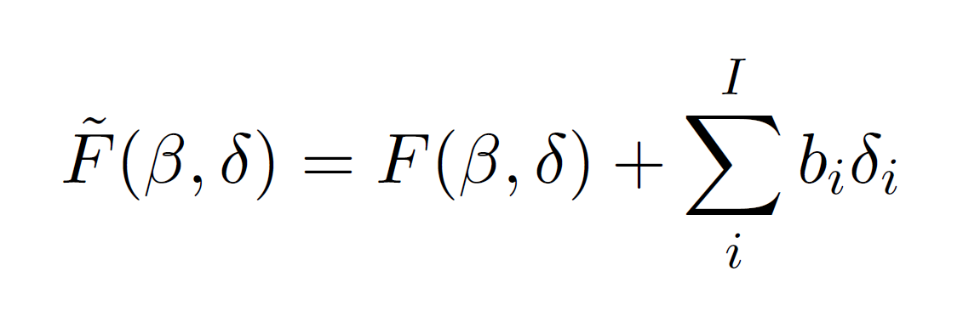
Two Differentially Private Methods
The parameters for the Rasch model are estimated by minimizing the (regularized) negative log-likelihood:
Sufficient statistic approach [Foulds2016]: noise scaled with (I / ε)
Objective perturbation [Chaudhuri2011]: noise scaled with (√I / ε)
Notes:
The objective perturbation is an approach invented by Chaudhuri et al, orignially for logistic regression, which is very close to the Rasch model. The concept here is to add noise to the objective function and then minimize the perturbed objective function instead. We showed in our paper that with this strategy we can add noise scaled with only sqrt(I)/epsilon; less noise than sufficients statistics because tune to objective sensitivity – while SS is stronger

Slide 11
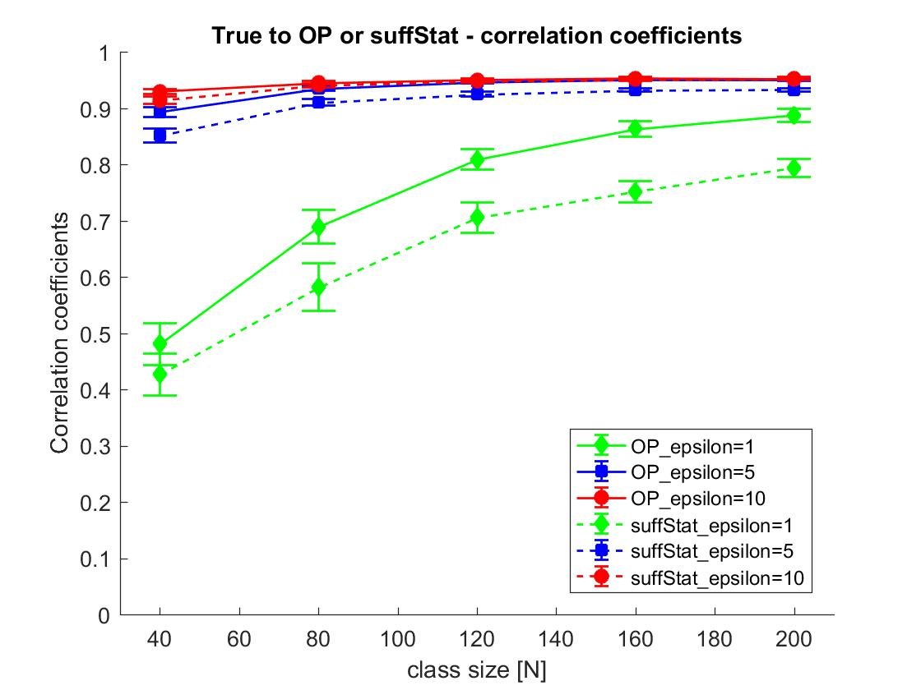
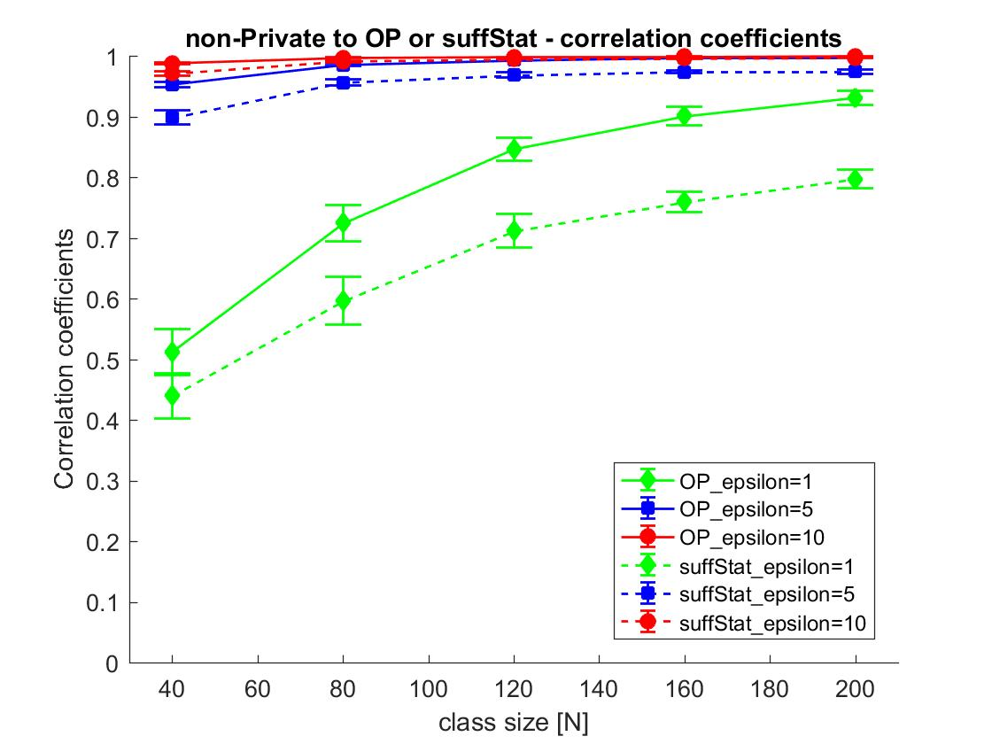
Experimental Results (1 / 3)
Simulated Data – Varying Epsilon, Correlation Coefficients to true / non-private

Slide 12
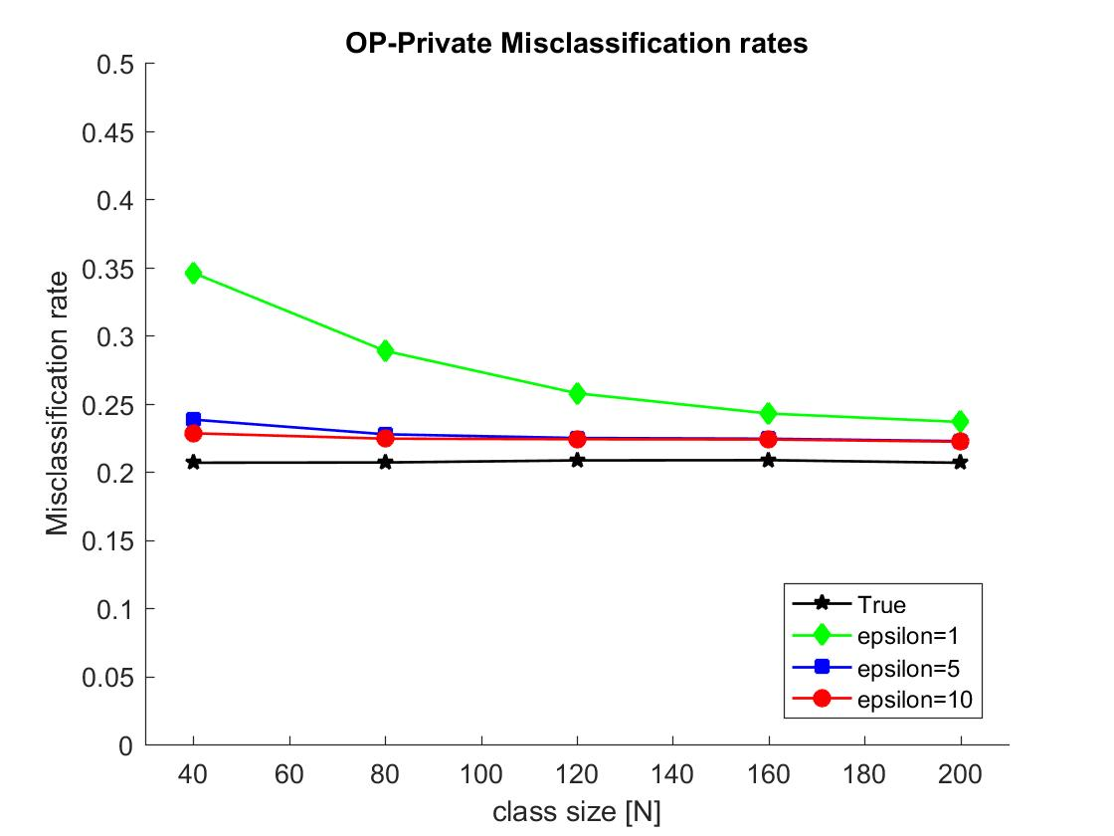
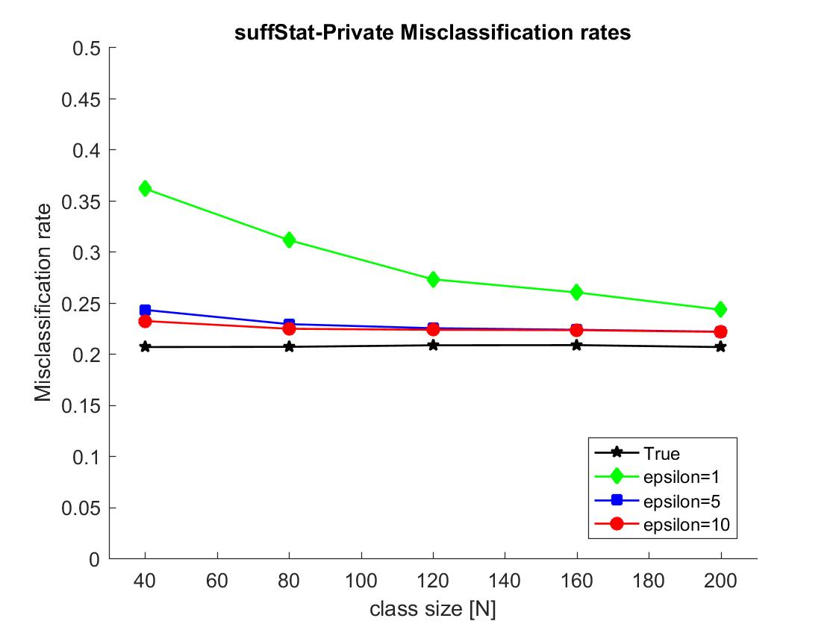
Experimental Results (2 / 3)
Simulated Data – Varying Epsilon, Misclassification rate to OP / Suff Stat

Slide 13
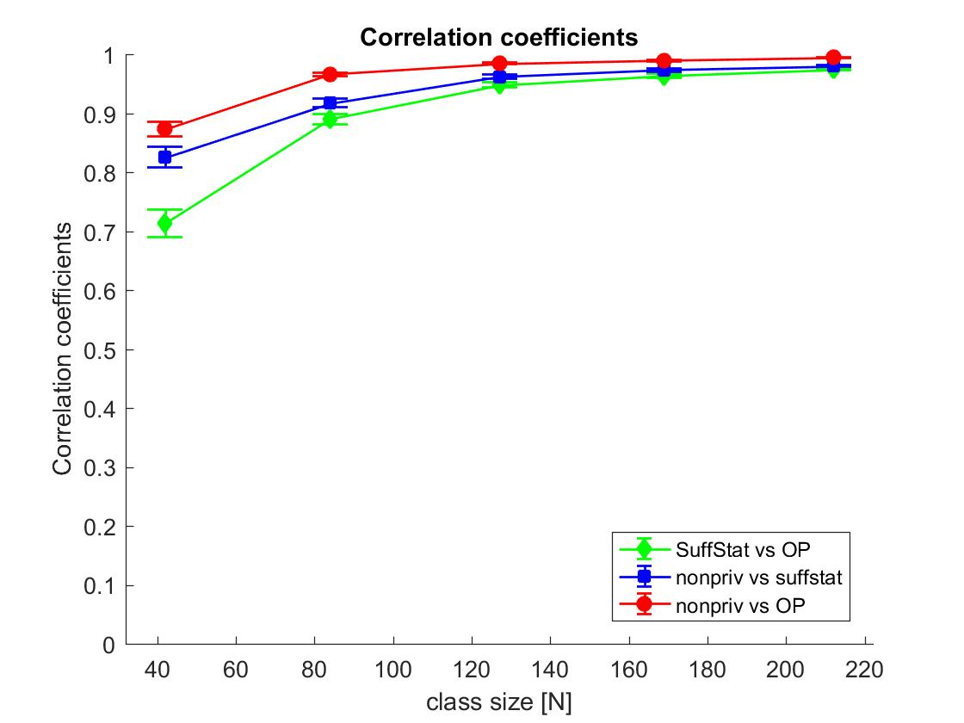
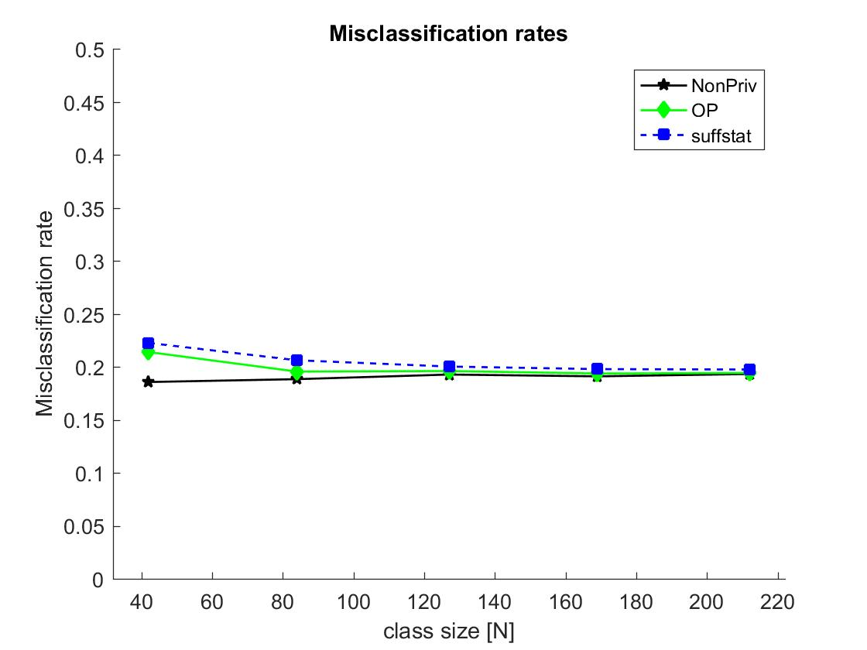
Experimental Results (3 / 3)
DTU data: ε = 5, bootstrapping with 50 repetitions

Slide 14
Conclusion
Introduced private workflow
Showed how two differentially private methods can be used in this context
Demonstrated practical viability on simulated and real data sets
Similar quality as non-private for medium sized classes and industry standard privacy budgets
Objective perturbation outperforms sufficient statistics
Further work?
✓
Notes:
Add a key plot To sum up: we introduced a private workflow for achieving the conflicting goals of individual feedback and differential privacy;
We showed how two previously introduced differentially private methods can be used in this context;
We demonstrated the practical viability of our approach on simulated and real data sets; where we get similar quality as the non-private Rasch model for medium sized classes and industry standard privacy budgets (epsilon 1 – 10)
And we have seen in general that the objective perturbation outperforms the sufficient statistics method in this case, due to the fact that we can add less noise.

Slide 15
References
[Dwork2006] Dwork, C., McSherry, F., Nissim, K., Smith, A.: Calibrating noise to sensitivity in private data analysis. In: Theory of cryptography conference. pp. 265–284. Springer (2006)
[Rasch1960] Rasch, G.: Studies in mathematical psychology: I. probabilistic models for some intelligence and attainment tests. (1960)
[Choppin1983] B. Choppin. A fully conditional estimation procedure for rasch model parameters (cse report 196): University of california. Center for the Study of Evaluation (1983)
[Foulds2016] Foulds, J., Geumlek, J., Welling, M., Chaudhuri, K.: On the theory and practice of privacy-preserving bayesian data analysis. In: Proceedings of the Thirty-Second Conference on Uncertainty in Artificial Intelligence. pp. 192–201. AUAI Press (2016)
[Chaudhuri2011] Chaudhuri, K., Monteleoni, C., Sarwate, A.D.: Differentially private empirical risk minimization. Journal of Machine Learning Research 12 (Mar), 1069–1109 (2011)
https://www.apple.com/privacy/docs/Differential_Privacy_Overview.pdf
Notes:
References: in [] within the text, then in list here
Slides and Codes available

Slide 16
Contact Info
Teresa Anna Steiner - s170063@student.dtu.dk
David Enslev Nyrnberg - s123997@student.dtu.dk
Lars Kai Hansen - lkai@dtu.dk
Codes and Slides available at:
https://github.com/DavidEnslevNyrnberg/PrivRaschPuplish
Notes:
Apple differential privacy technical overview – epsilon 2, 4, 8

Slide 17
Attributions for Graphics
Differential Privacy: Wang, Hao, Zhengquan Xu, and Shan Jia. "Cluster-Indistinguishability: A practical differential privacy mechanism for trajectory clustering." Intelligent Data Analysis 21.6 (2017): 1305-1326.
Good job! https://www.flickr.com/photos/albertogp123/5843148207
Speed_ballonicon2 https://commons.wikimedia.org/wiki/File:Speed_ballonicon2.svg
Creative Tail medicine https://commons.wikimedia.org/wiki/File:Creative-Tail-medicine.svg
Digital Marketing https://fangdigital.com/what-is-digital-marketing/
Notes:
???

